Slide 1
SIFT Based Seafloor Mapping For Autonomous Underwater Vehicles

Slide 2
What is an AUV?
AUV- Autonomous Underwater Vehicle
It is an fully self sustainable, usually battery powered underwater vehicle capable to diving deep down to the ocean surface to study marine life, explore chemical and material properties, map the ocean surfaces and many other applications.
The main control surfaces of the AUV are the Fins-for roll and depth and the propellers – for the speed, by using these the AUV can maneuver itself underwater.
The AUV also has diverse sensor suite ranging from multiple SONARs-for Navigation and mapping, Cameras for computer vision based application such as mapping, underwater photography , study the diverse marine life ,etc. The AUV can also have additional sensors and experimental equipment mounted on it based on the scope of the experiment.
The main advantage of an AUV lies it in its size, low cost and less danger to the people working on the project.

Slide 3
Abstract/Introduction
The most important use of an Autonomous Underwater Vehicle (AUV) is the ability for it got to places and observe them where it is difficult for human controlled cameras and map the area and give detailed information about the properties of that seafloor.
AUVs can produce Maps of the seafloor which can then later be used for marking the corals, elevations, vents, rocks, biological remains(carcasses), waste etc. Moving the AUV in a guided pattern collecting images and videos of the seafloor that have to then be combined and processed together to construct a view able map to the seafloor.
Additionally, AUV is equipped with SONAR to find the distance from the seabed and the elevations generated by the ridges, debris, reefs, marine life etc. The Sonar data allows us to determine how the seabed varies and mark the elevations in the MAP for further use in analysis.

Slide 4
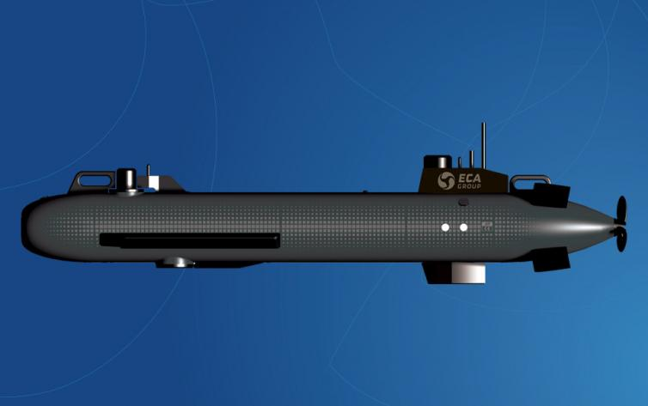
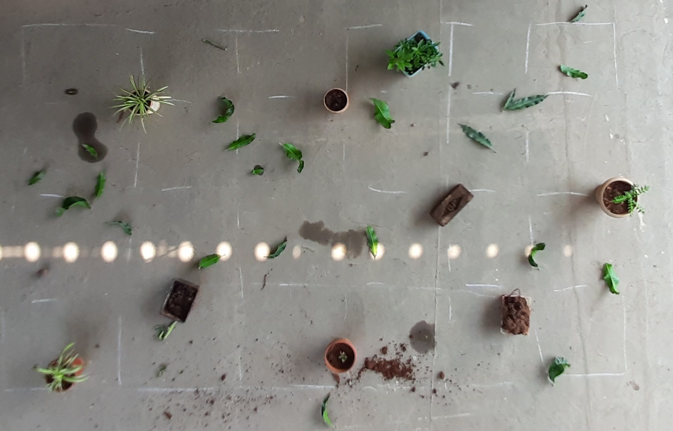
Objective:
The main aim of our project is to find rectangular maps of the small sections seafloor using small scale AUV such as eca_a9.
“A9-M is the configuration of ECA Group A9 men portable Autonomous Underwater Vehicle, AUV, dedicated to defence and security applications.
This underwater drone has been designed to meet STANAG 1364 requirement: its acoustic and magnetic signatures are minimized in order not to trigger any underwater mines when doing the mine warfare survey.
Its main function is Mine Like Objects detection and even classification depending on environmental conditions and seabed type in particular
”
ECA_A9M AUV
Expected Map full view

Slide 5
Review of Literature
There are some organization's which are working on seafloor mapping with AUVs. MBARI has AUVs with four SONAR sensors each in which two side scan sonars, The Swath Multibeam Sonar measures depth to the ocean floor and Sub-Bottom profiler, detects the layers between sediments.
The Seafloor Mapping Group (SFMG) supports coastal and marine geographic research. It uses Acoustic and Optical techniques for seabed study. SFMG includes still photographs, seismic reflection systems and sediment collection from the underwater. They also study the sea surface in addition to the Underwater.

Slide 6
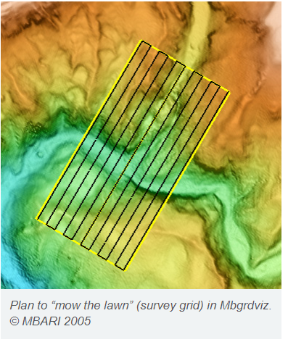

Slide 7
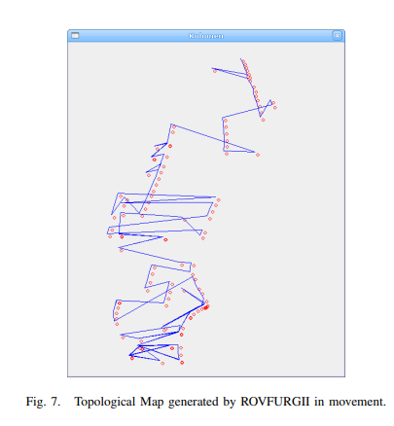
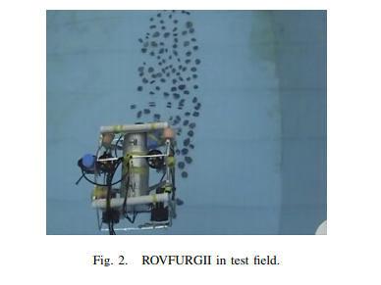
In the Paper “SLAM in Underwater Environment using SIFT and Topologic Maps” by “Paulo Drews Jr, Silvia Botelho and Sebastião Gomes. October ,2008.” use SIFT for navigation/odometry , detect and extract visual features from underwater surfaces using AUV and generated topologic maps of the path followed by the AUV. They also used the SIFT features for visual SLAM(Simultaneous Localization and Mapping) and noise reduction of images and path using Gaussian Filters.

Slide 8
Methodology:
Our project on Seafloor mapping aims to map rectangular sections of the seafloor using AUV(Autonomous Underwater Vehicles).
The project aims to use only cameras and vision based systems to map the desired region on the map. We will choose an area at the selected location to map it, and the AUV will be programmed to follow a path as shown in Fig.1.
The cameras present on the AUV underside will capture images continuously with breaks at respective areas, they go along the route.
The cameras will be capturing images only as the AUV moves in a vertical path and will be off during the turn the AUV makes to realign itself parallel to the direction it transited before. This process continues until the AUV reaches the end of the area it has to cover during the mapping expedition.

Slide 9
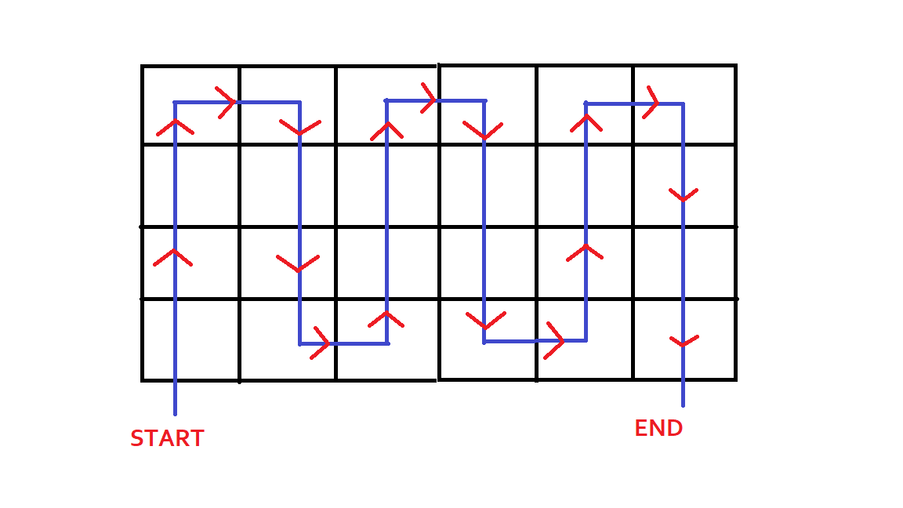
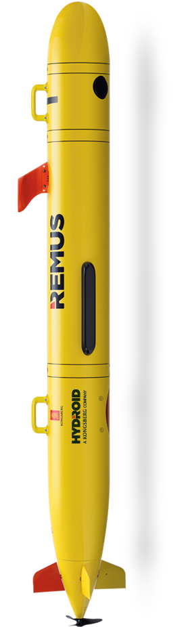
The path followed by AUV:

Slide 10
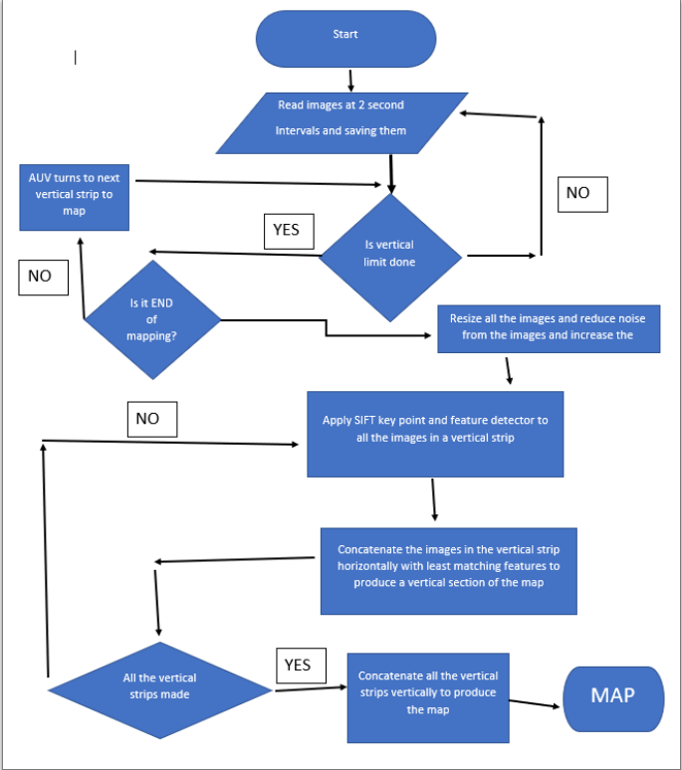
Flow chart of expected algorithm

Slide 11
Experiment Setup
Using a handheld digital camera, we followed it through the path described in Fig.1 as the trajectory of the AUV; the camera was a 2mp digital webcam.
The camera capture 60 frames per second, and the average speed of an AUV is 1.5 to 2m/s. The handled camera roughly maintained the rate of ~1.6 to 1.7m/s.
The algorithm is aimed at generating clear maps of the seabed and a camera with a focal distance of < 2 feet. The AUV(handheld camera) will be at an height of 1.5 to 2 feet to the seabed(ground/mapping surface).
The height will be determined by the camera’s focal distance adjusted to parameters of the water surrounding it. in the test case, it will beset to the default focal length

Slide 12
The Algorithm:
Image capturing
The cameras will be capturing images only as the AUV moves in a vertical path and will be off during the turn the AUV makes to realign itself parallel to the direction it transited before. This process continues until the AUV reaches the end of the area it has to cover during the mapping expedition.
The AUV captures images in the vertical paths called "strips" consecutively. Each upright portion will be stored and processed separately before merging them to generate an image.
To make the vertical portions "strips," we will be applying the SIFT algorithm to find each image's key points and descriptors.
We start by capturing 200 images frame by frame as the AUV moves through the vertical segments. It will store the images in a folder temporarily.

Slide 13

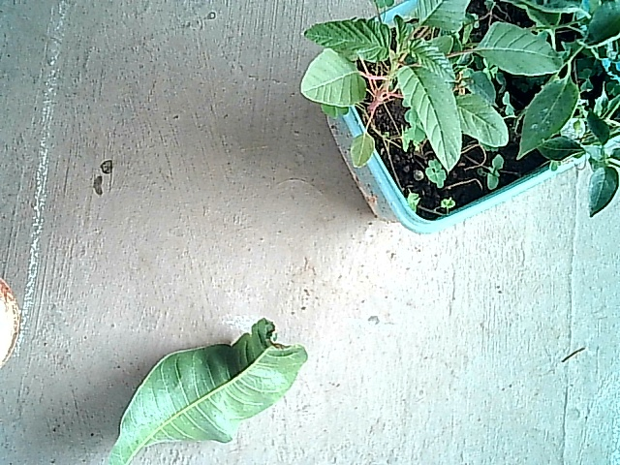

Loading the images into a useable array
The images will be updated into a list, simultaneously applying the SIFT algorithm using OpenCV. The images are updated into the array and will be resized to (256, 256, 3), i.e., 256 pixels wide, 256 pixels long, and with the three channels RGB respectively. The camera captures RGB images which will be converted to BGR.
Image List containing 200 images of size (256,256,3)

Slide 14
SIFT Overview Since SIFT is the backbone of our project this is a barebones overview
The sift algorithm is used to find the key points and the feature descriptors of each of the images.
The SIFT method uses a Difference of Gaussian (DoG) to see the difference between the different Gaussian blurring of the image with different sigma (σ) values. This same process will be repeated for different octaves in the Gaussian pyramid.
Therefore, the scale space of an image is defined as a function, L(x, y, σ), that is produced from the convolution of a variable-scale Gaussian, G(x, y, σ), with an input image, I(x, y):

Slide 15
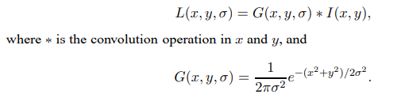

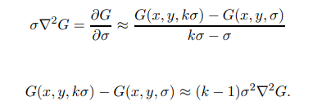
L(x,y,σ) is the scale space function.
G(x,y, σ) is the gaussian function.
I(x,y) is the input image.
D(x,y, σ) is the Difference of Gaussian Function.
σ 2∇2G is the scale normalized Laplacian of Gaussian.
The factor (k − 1) in the equation is a constant over all scales and therefore does not influence extrema location

Slide 16
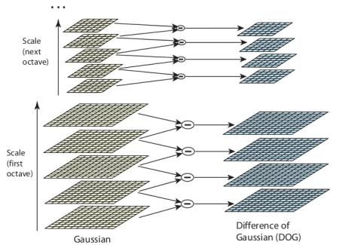
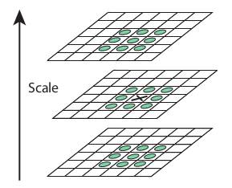
After the Difference of Gaussians(DoG) are found, we search the images for(the same image with different Gaussian Blurring ) for a local extremum over scale and space. The individual pixels in an image are compared with its eight neighbors, nine pixels in the next layer, and nine pixels in the previous layer. If the pixel is a local extremum is a potential key point.
The paper summary gives us empirical data, no octaves = 4, number of scale levels = 5, initial sigma = 1.6, etc.
The approximation error will go to zero as k goes to 1, but in practice we have found that the approximation has almost no impact on the stability of extrema detection or localization for even significant differences in scale, such as k = √ 2.

Slide 17
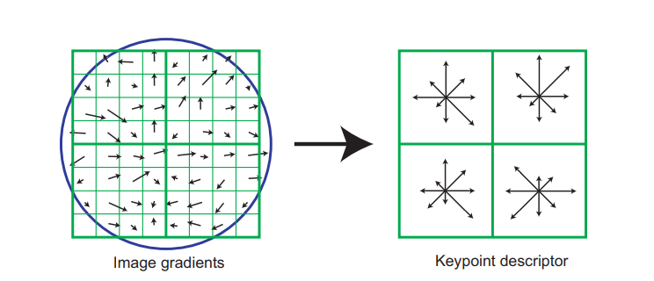
“Once all the key points are localized, they must be optimized and refined to amount for dual detections and multiple corner detection. They used Taylor series expansion of scale-space to get a more accurate location of extrema. If the intensity at this extrema is less than a threshold value (0.03 as per the paper), DoG has a higher response for edges, so edges also need to be removed. For this, a concept similar to the Harris corner detector is used. They used a 2x2 Hessian matrix (H) to compute the pricipal curvature. We know from the Harris corner detector that for edges, one eigen value is larger than the other. So here they used a simple function.”

Slide 18
3. Application of SIFT
The images loaded into their specific arrays of each vertical segment are passed one image array at a time through a function that applies Scale Invariant Feature Transform(SIFT) on each of the images.
The SIFT function in OpenCV allows us to detect the key points and feature descriptors of the images.
The key points give us information about the image location, scale, and orientation. All these parameters embedded within the keypoint descriptor estimate a 2D coordinate system
that constantly describes the local image region throughout and different for each image.

Slide 19
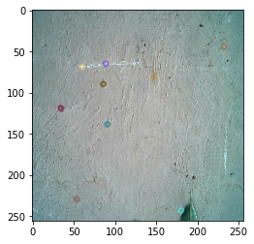
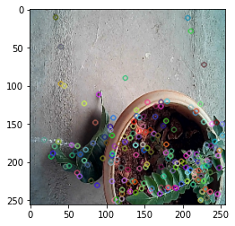
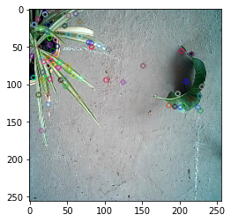
The function also computes the descriptor of the images by adding each image’s gradient magnitude and orientation around a keypoint location a Gaussian window, then weights the values to define the final descriptor. These values also account for the change in 3D orientation and illumination to remove false-positive key points and descriptors. We still need to retain the values of the key points and descriptors for each image to use them further, which will append into corresponding arrays.

Slide 20
4. Forming of each vertical segment
We are considering an area of 4x6 segments with each segment of size ~ (30cmx 30cm)
We have each of the images with key points plotted onto them, their respective key points and feature descriptors To form each of the vertical segment we will be comparing the images taken consecutively as the AUV passes over the vertical segment stored in the array.
To compare them we will be using the simple Brute Force matcher technique of OpenCV. Each of the images with their corresponding keypoints and feature descriptors is loaded into a function and two empty array named matches and strip.” For BF matcher, first we have to create the BFMatcher object using cv.BFMatcher(). It takes two optional params. First one is normType. It specifies the distance measurement to be used. By default, it is cv.NORM_L2. It is good for SIFT, SURF etc (cv.NORM_L1 is also there).”

Slide 21

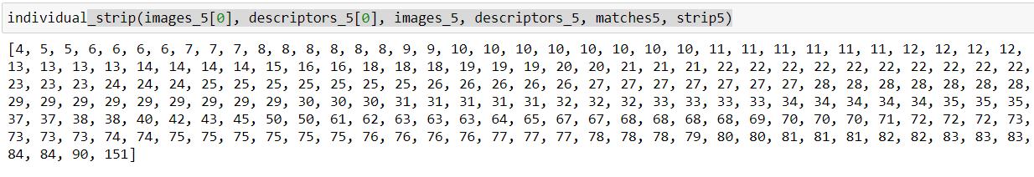
The first image in each of yhe sequence is macthes with all the images .
Upon Matching an image pair the match fuction generates a certain no of values, which are defined as “matche” this consists of a values , when each of the feature descriptors are matched from noth the images.
In this application we are cosinering only the size of the list ,i.e., no_of_matches per image pair and we are appending it into the matches array.
The array is sorted in increasing order, this is gives us the least matches with the first image.

Slide 22
As the images corresponding to the higher matches represent simmmilar images, the values greater than the mean of the list are discarded and only the less values are considered.
To only account for the different frames in each of the vertical segments the images with less than half the mean of the are considered and repeating matches are discarded.
Now we will theoretically left with images wift different frames.
These ,atches are then corresponded with the order of the frames and are concatenated together vertically to form the vertical segment
This process is repeated till all the vertical segments have been formed.
5. Making of the Map
The alternate vertical segments are flippled on the x axis to account for the movement of AUV in opposite direction.
The completed vertical segments are appended into an array and concatenated together horizontally to form the Map/

Slide 23


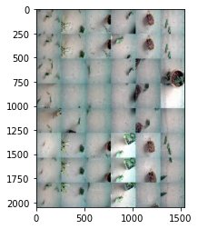
Horizontal concatenation of vertical segments
Alternate vertical segments flipped on x axis
V
E
R
T
I
C
A
l
C
O
N
C
A
T
E
N
A
T
I
O
N
AUV passes over a vertical portion
SIFT & BF Matcher
Approximate Map
Image array with key points detected
Vertical Segment

Slide 24
Expected MAP
Output/generated MAP
Accuracy is around 55 - 60% including human error

Slide 25
6. Constraints of the study:
This research was intended to develop an algorithm for Mapping relatively small rectangular areas of the seafloor to produce a geographical map of the seabed. In the study, we simulated the underwater environment of a submersible AUV moving using a handheld digital camera. This mapping algorithm can be deployed to various AUVs which are intended to map similar surfaces.

Slide 26
7. Conclusions
In this project we have simulated a mapping algorithm for AUVs that are indented to MAP small portions of the seabed visual cameras.
The automated algorithm gives an easy way to deploy the AUV and obtain mapped results.
As the features of the image are retained we can use them for further vision based applications such as classification and machine learning.
8. Future Work
To increase the accuracy of Map generated.
Expect to Add SONAR sensors to create a 3d depth MAP of the surface by plotting the depth values.
Using the images to classify underwater plants.
AUV navigation using SIFT

Slide 27
Thank You
Raghuram C S
2019A3PS0357H
Sai Anoop
2019A8PS0506H

